Slide 1



OPPORTUNITY REVIEW
DIRECT-TO-EMPLOYER GTM STRATEGY
Exploring a Tower DTE Health Plan

Slide 2


Founded in 1979, headquartered in Indianapolis
Largest Independently-Owned Full-Service Third-Party Administrator
Specialize in Administration of Self-Funded Plans and Population Health Management​
Leader in the Direct-to-Employer Movement
We Know and Understand the Market
Experience Working with All Professional Teams: Agents, Networks, MGAs
The Key Family of Companies is a Vertically Integrated group of benefit related organizations
3,000+ Corporate Clients
3 Million Members under Management
700 Employees

Slide 3


MARKET LEADER
IN
PRIVATE LABELED
DTE PLANS
Louisville, KY
OneHealth Plan
Cincinnati, OH
TCH Optimal
Bentonville, AR
Northwest Health Plan
Knoxville, TN
East Tennessee Health Plan
Meridian, MS
Affinity Health Plan
Fort Myers, FL
Lee Health Care Partners

Slide 4


DIRECT-TO-EMPLOYER (DTE)
YOU Pick the Name of the Health Plan
YOU Determine the Fees Charged
YOU Practice the Medicine
YOU Receive the Profits
WE Make it Successful
Your Health Plan Focused on a Direct Relationship with Self-Funded Employers in Your Market

Slide 5
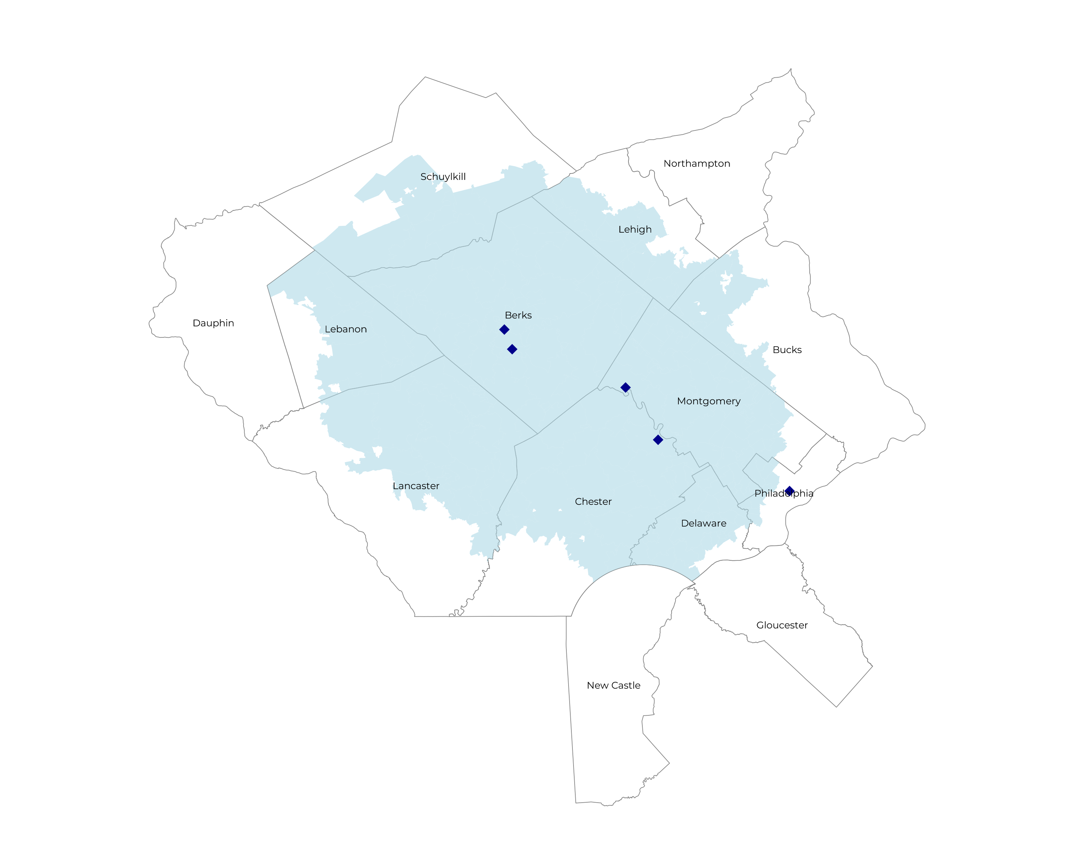
SIGNIFICANT OPPORTUNITY FOR PLAN GROWTH Researched for the below highlighted service area
Target Market 3,920 Employers 900,000+ Employees 1,400,000+ Members
 | Total Employees
Commercial Employers With Headquarters: | 50-100 | 101-200 | 201-400 | 401-1000 | 1001-3000 | 3000+
Within 10 Miles of Tower Health Hospital | 934 | 351 | 257 | 162 | 52 | 56
Within 11-20 Miles of Tower Health Hospital | 1,179 | 463 | 295 | 167 | 60 | 43
Within 21-30 Miles of Tower Health Hospital | 222 | 83 | 59 | 26 | 7 | 4
Employees at Above Firms | 50-100 | 101-200 | 201-400 | 401-1000 | 1001-3000 | 3000+
Within 10 Miles of Tower Health Hospital | 70,050 | 52,650 | 77,100 | 113,400 | 104,000 | 504,000
Within 11-20 Miles of Tower Health Hospital | 88,425 | 69,450 | 88,500 | 116,900 | 120,000 | 387,000
Within 21-30 Miles of Tower Health Hospital | 16,650 | 12,450 | 17,700 | 18,200 | 14,000 | 36,000
Total Members at Firms | 50-100 | 101-200 | 201-400 | 401-1000 | 1001-3000 | 3000+
Within 10 Miles of Tower Health Hospital | 112,080 | 84,240 | 123,360 | 181,440 | 166,400 | 806,400
Within 11-20 Miles of Tower Health Hospital | 141,480 | 111,120 | 141,600 | 187,040 | 192,000 | 619,200
Within 21-30 Miles of Tower Health Hospital | 26,640 | 19,920 | 28,320 | 29,120 | 22,400 | 57,600

Slide 6
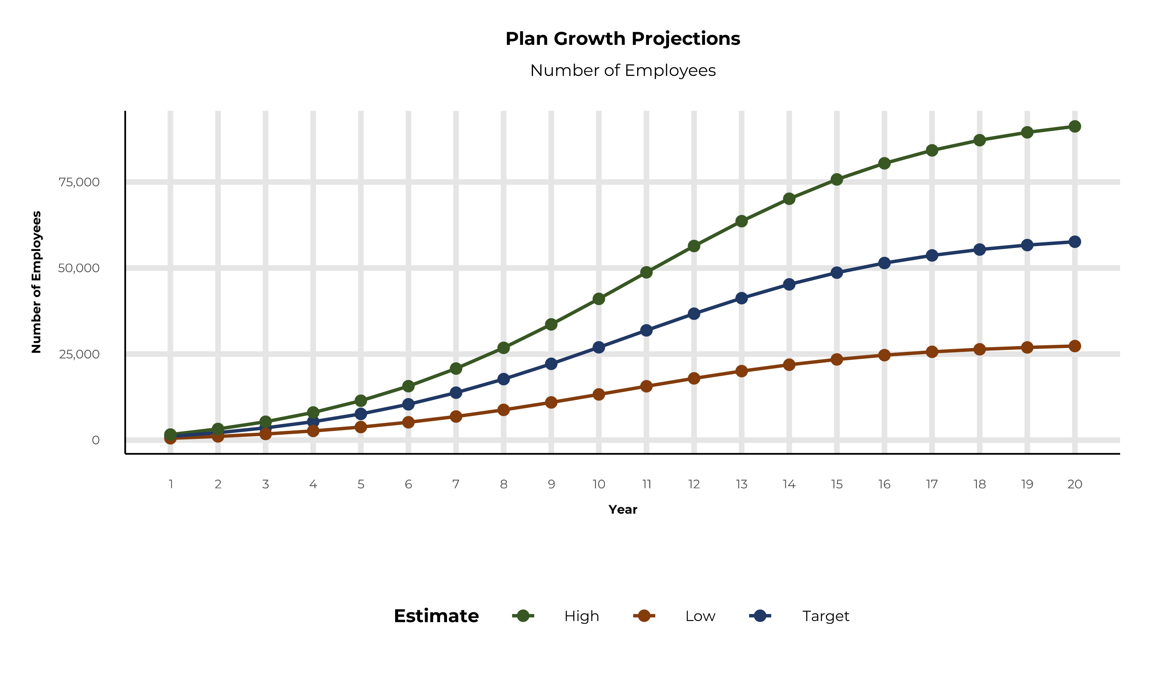
PLAN POTENTIAL GROWTH PATHS
Self Funded
790K
Insured
1,364K
Working Age
1,802K
Population
3,071K
Estimates includes the Tower Health service area in Berks, Bucks, Chester, Delaware, Lancaster, Lebanon, Lehigh, Montgomery, Philadelphia, and Schuylkill Counties

Slide 7
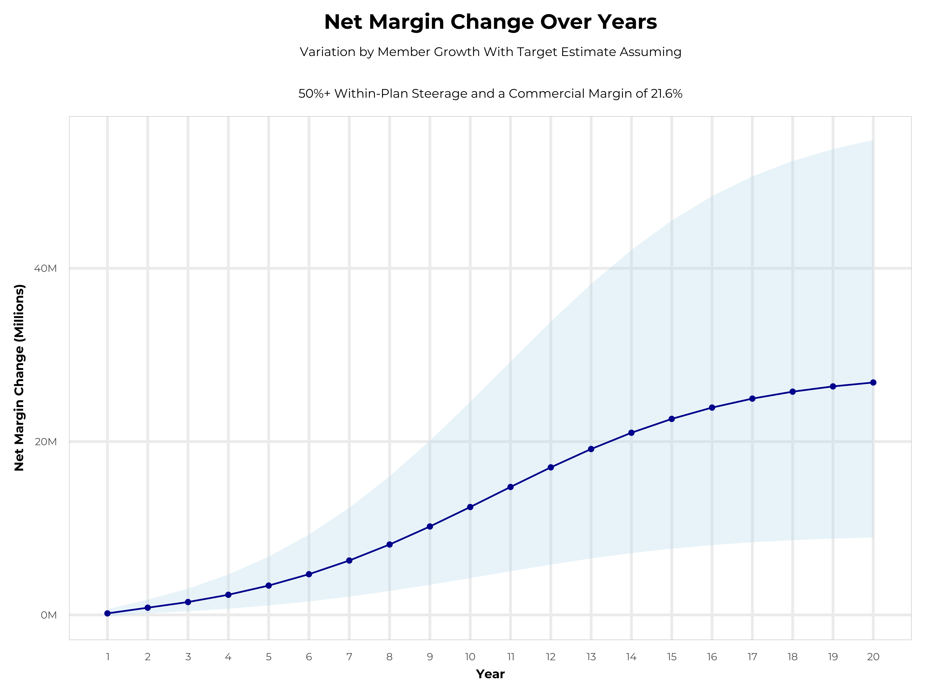
GROWING POWERFUL, LASTING PROFITABILITY
Early Stage
Gaining Name Recognition, Early Growth
New Revenue:
New Profit:
$10.34M
$2.15M
Growth Stage
Strong Reputation, Strong Growth
New Revenue:
New Profit:
$56M
$12.57M
Mature Stage
High Profitability, Market Saturation
New Revenue:
New Profit:
$108.39M
$24.5M

Slide 8
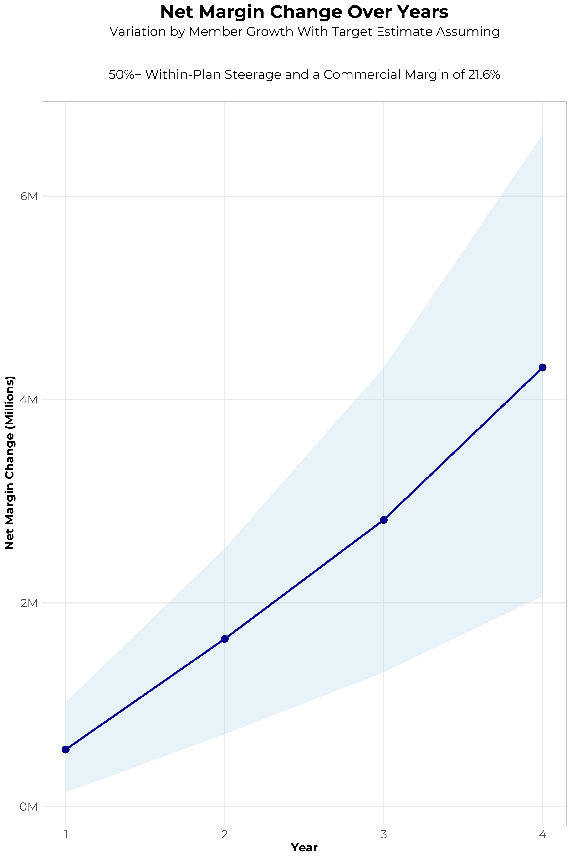
FOUR-YEAR PROJECTIONS
Target Member Growth | Target Member Growth | Target Member Growth | Target Member Growth | Target Member Growth
Metric | Year 1 | Year 2 | Year 3 | Year 4
Number of Members | 1,900 | 3,900 | 6,400 | 9,600
Incremental Margin | 867.3K | 1,780.3K | 2,920.5K | 4,380.3K
Network Access Fee | 22.8K | 46.8K | 76.8K | 115.2K
Implementation Fee (One-Time) | -150.0K | 0.0K | 0.0K | 0.0K
Sales and Marketing Costs | -180.0K | -180.0K | -180.0K | -180.0K
Net Margin Change | 560.1K | 1,647.1K | 2,817.3K | 4,315.5K
High Member Growth | High Member Growth | High Member Growth | High Member Growth | High Member Growth
Metric | Year 1 | Year 2 | Year 3 | Year 4
Number of Members | 2,900 | 5,800 | 9,600 | 14,500
Incremental Margin | 1,323.8K | 2,647.6K | 4,380.8K | 6,616.0K
Network Access Fee | 34.8K | 69.6K | 115.2K | 174.0K
Implementation Fee (One-Time) | -150.0K | 0.0K | 0.0K | 0.0K
Sales and Marketing Costs | -180.0K | -180.0K | -180.0K | -180.0K
Net Margin Change | 1,028.6K | 2,537.2K | 4,316.0K | 6,610.0K
Low Member Growth | Low Member Growth | Low Member Growth | Low Member Growth | Low Member Growth
Metric | Year 1 | Year 2 | Year 3 | Year 4
Number of Members | 1,000 | 1,900 | 3,200 | 4,800
Incremental Margin | 456.5K | 867.3K | 1,460.3K | 2,190.1K
Network Access Fee | 12.0K | 22.8K | 38.4K | 57.6K
Implementation Fee (One-Time) | -150.0K | 0.0K | 0.0K | 0.0K
Sales and Marketing Costs | -180.0K | -180.0K | -180.0K | -180.0K
Net Margin Change | 138.5K | 710.1K | 1,318.7K | 2,067.7K

Slide 9
PROJECTED PLAN GROWTH
Year | Employees | Members | Percent of Members Choosing Tower for Inpatient Care | Percent of Members Choosing Tower for Outpatient Care
1 | 1,100 | 2,000 | 20% | 20%
2 | 2,200 | 4,000 | 20% | 20%
3 | 3,600 | 6,500 | 20% | 20%
4 | 5,300 | 9,500 | 20% | 20%
5 | 7,600 | 13,700 | 20% | 20%
6 | 10,400 | 18,700 | 20% | 20%
7 | 13,800 | 24,800 | 20% | 20%
8 | 17,700 | 31,900 | 20% | 20%
9 | 22,200 | 40,000 | 20% | 20%
10 | 27,000 | 48,600 | 20% | 20%
11 | 31,900 | 57,400 | 20% | 20%
12 | 36,700 | 66,100 | 20% | 20%
13 | 41,200 | 74,200 | 20% | 20%
14 | 45,300 | 81,500 | 20% | 20%
15 | 48,700 | 87,700 | 20% | 20%
16 | 51,500 | 92,700 | 20% | 20%
17 | 53,700 | 96,700 | 20% | 20%
18 | 55,400 | 99,700 | 20% | 20%
19 | 56,700 | 102,100 | 20% | 20%
20 | 57,600 | 103,700 | 20% | 20%
KBA currently estimates that Tower Health has 5% inpatient market share, and 3% outpatient market compared to hospitals/clinics in the Tower Health service area (see slide 8).
Based on previous DTE experience, KBA expects a significant bump in patient steerage to Tower Health.
Additional steerage will occur from additional steerage patient benefits and the patient card.
High estimates start nearly 10% higher than target with low estimates at 10% lower than target

Slide 10
YEAR 4 PROJECTED REVENUE AND PROFIT
Pre-DTE Cohort of 9,600 Employees | Inpatient | Outpatient | Professional | Total
Revenue† | $ 1,637,580 | $ 1,741,998 | $ 813,498.3 | $ 4,193,076
Net Income‡ | $ 353,717.3 | $ 376,271.6 | $ 175,715.6 | $ 905,704.5
† Assuming proportional revenues from market shares of 5% (inpatient) and 3% (outpatient)
‡ Conservatively assuming a commercial margin of 21.6% (80% of the estimated commercial margin)
With DTE | Inpatient | Outpatient | Professional | Total
Revenue⁰ | $ 6,528,130 | $ 11,868,282 | $ 5,542,387 | $ 23,938,799
Net Income* | $ 1,410,076 | $ 2,563,549 | $ 1,197,156 | $ 5,170,781
⁰ Assuming 20% inpatient and 20% market steerage based on KBA narrow network DTE experience (see previous slide)
* Conservatively assuming a commercial margin of 21.6%, with a 10 percentage-point reduction to reflect competitive-edge rates and a 10 percentage-point increase due to lower billing costs and higher patient responsibility collections because of the member credit card.
Total Increase in Net Income | $ 4,265,076
Network Access Fee (Revenue) of $1 PMPM | $ 115,200
Total Profit Growth | $ 4,269,876
Minus Implementation Fee (One-Time) | -$ 0
Minus Sales and Marketing (Annual – Ongoing) | -$ 180,000
Total | $ 4,200,276

Slide 11





A PARTNER YOU CAN TRUST
OUR OBJECTIVES ARE ALIGNED
WE KNOW THE
MARKET
COMPLETELY TRANSPARENT
WE HAVE THE SOPHISTICATION AND INFRASTRUCTURE TO EFFECTIVELY COMPETE
Derek Moore, Senior Vice President – KBA
845-283-9973 * derek.moore@keybenefit.com

